Slide 1
Endpresentation

Slide 2
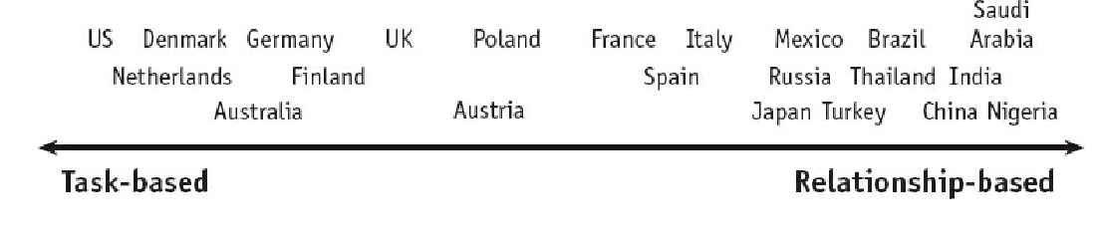
The Trusting Scale
“trust is built trough business-related activities. Work relationships are built and dropped easily, based on the practicality of the situation. You do good work consistently, you are reliable, I enjoy working with you, I trust you.”
“trust is built trough sharing meals, evening drinks, and visits at the coffee machine. Work relationships build up slowly over the long term. I´ve seen who you are at the deep level. I´ve shared personal time with you, I know others well who trust you, I trust you.”

Slide 3
Examples and solutions for building trust
Example 1: Gerdau merger
Example 2: Nestle acquisition
Guannxi: “translates loosely as personal connections, relationships or social networks”
Building trust from a task-based country:
build a personal relationship
spending time with the person, talking about personal information
presenting gifts
Building trust from a relationship-based country:
accept that the lack of personal discussions
As a result one should also
be as efficient as possible

Slide 4
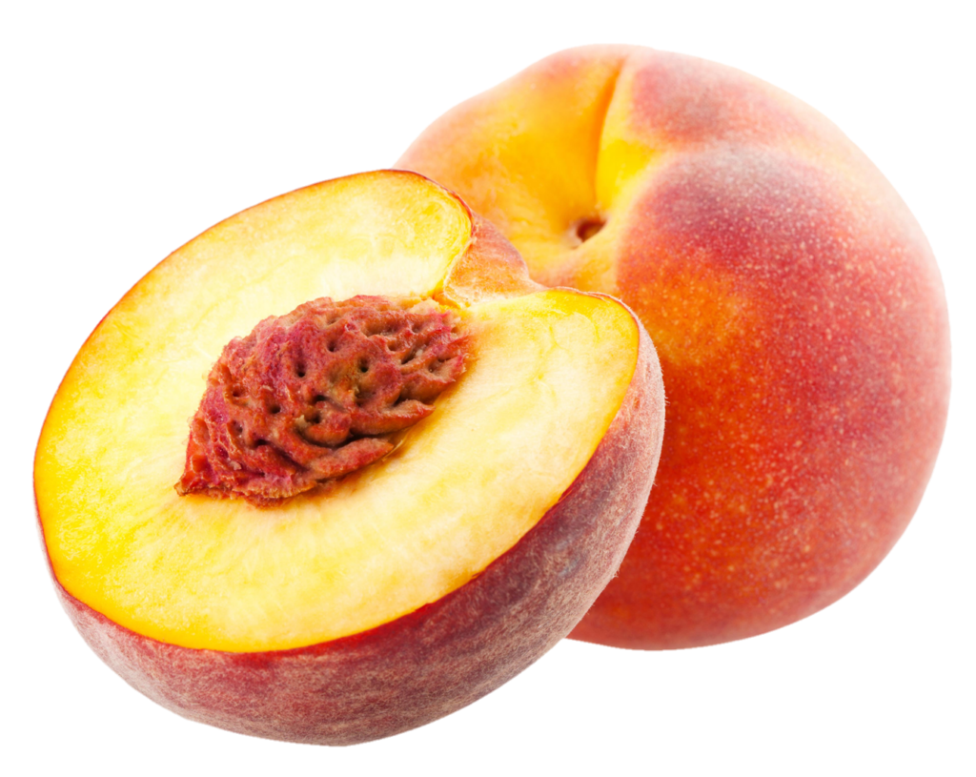
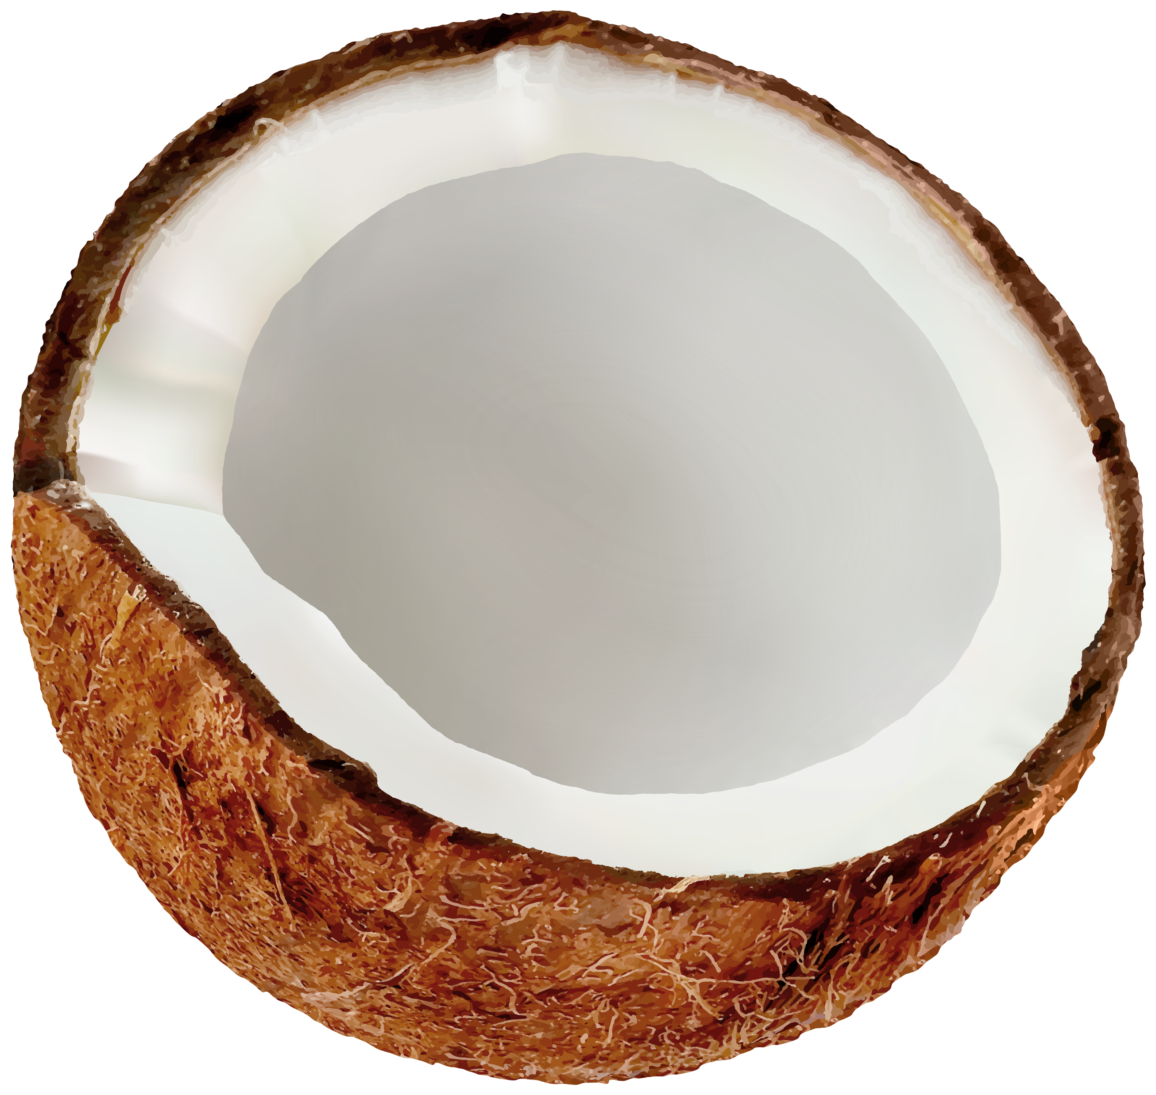
peach vs. coconut cultures
https://pngfre.com/wp-content/uploads/peach-png-image-from-pngfre-33-1024x815.png
https://i.pinimg.com/originals/dd/3f/8f/dd3f8f13aecf1c3e441facf64961423f.png

Slide 5
Possible communication devices and when to utilise them
In task-based societies: the most efficient way is the best way. One can use email, telephone or meetings, whatever suits the occasion best.
In relationship-oriented countries:
choose the most personal type of communication possible
Instead of emailing someone, one can take the phone, or best meet them personally.
If a bond is established, one can use email

